Slide 1

Sujith Quintelier – Member of Cloud of Expert (Azure)
Azure Overview
Notes:
Welcome
Introduction
CoE
Start from existing App

Slide 2
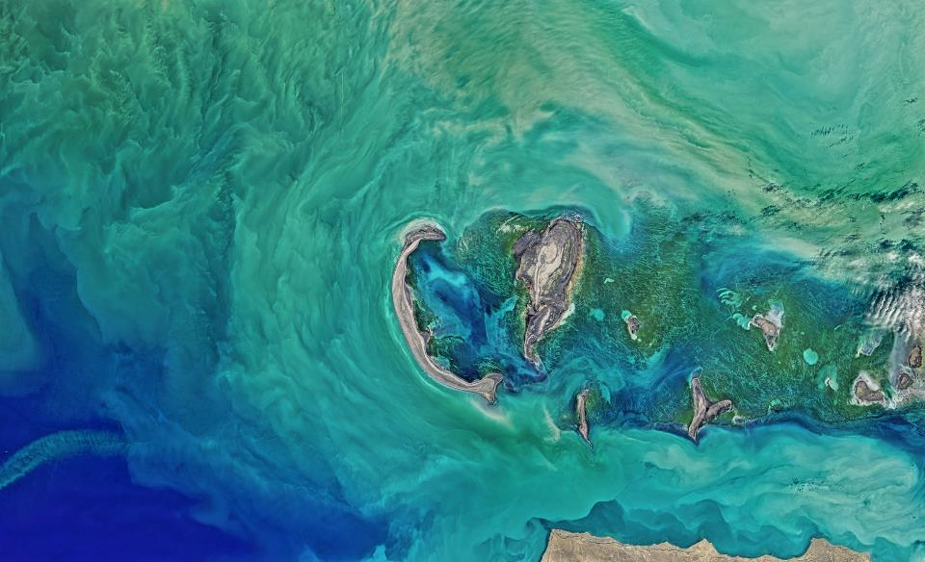
Next
VSTS

Slide 3





01
VSTS
Planning
Git
CI/CD
VSTS

Slide 4
Next
Hosting

Slide 5



02
HOSTING
App Services
Web
Function
Logic

Slide 6

02
HOSTING
Virtual Machines
VM

Slide 7


02
HOSTING
Containers
ACI
ACR
Web

Slide 8




02
HOSTING
Micro Services
Service Fabric
ACS
AKS
Service Fabric Mesh

Slide 9
Next
Data

Slide 10





03
DATA
Storage
Blob
File
Table
Disk
Data Lake

Slide 11





02
DATA
Database
SQL
Elastic
Pool
Data Warehouse
SQL
Stretch
Redis
Cache
Notes:
SQL Server on VM
PostgresSQL

Slide 12
Next
Messaging

Slide 13

04
MESSAGING
Messages
Storage
Queue

Slide 14




04
MESSAGING
Events
Event
Hubs
Event
Grid
Service
Bus
Queue
Service
Bus
Topic

Slide 15
Next
Scalling

Slide 16
05
SCALING
Scaling
Instances
Auto scaling
VMSS
DTU
RU
Extra Nodes
...

Slide 17
Next
Performance & Availability

Slide 18



06
PERFORMANCE
&
AVAILABILITY
Performance & Availability
Traffic
Manager
Application
Gateways
Load
Balancers
Availability
Zones

Slide 19
Next
Networking

Slide 20




07
NETWORKING
Networking
DNS
Virtual
Networks
Express
Route
VPN
Gateway

Slide 21
Next
All Kind

Slide 22



08
ALL KIND
Security
Notes:
AAD – For Developers, B2C, Domain Services,
Key Vault
Multi-Factor Authentication

Slide 23





08
ALL KIND
???
Notes:
Media Services
Search
Cognitive Services (Text Analytics, Face API, Computer Vision API, Custom Vision API, Speech, …)
Bot Services
API Management

Slide 24
09
CoE
Azure CoE

Slide 25
10
QUESTIONS
Questions
???

